Slide 1
Flash Attention
Tri Dao
Presented by: Mike Doan

Slide 2
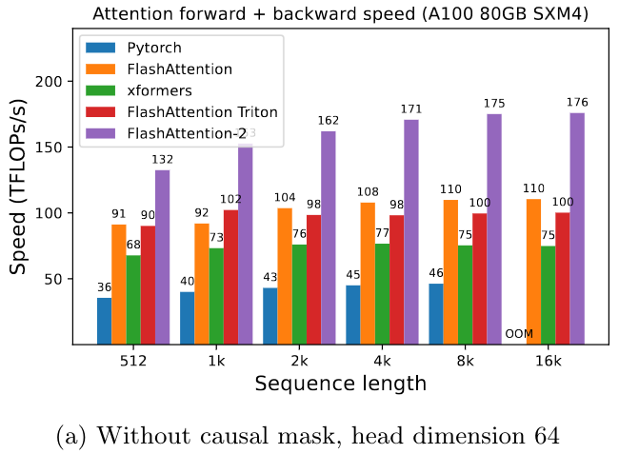
Summary
~4x faster *exact* attention
Memory requirements dropped from O(n^2) to O(n)
Significantly decreases training and inference costs of large models
Enables larger contexts sizes with no hardware upgrades

Slide 3
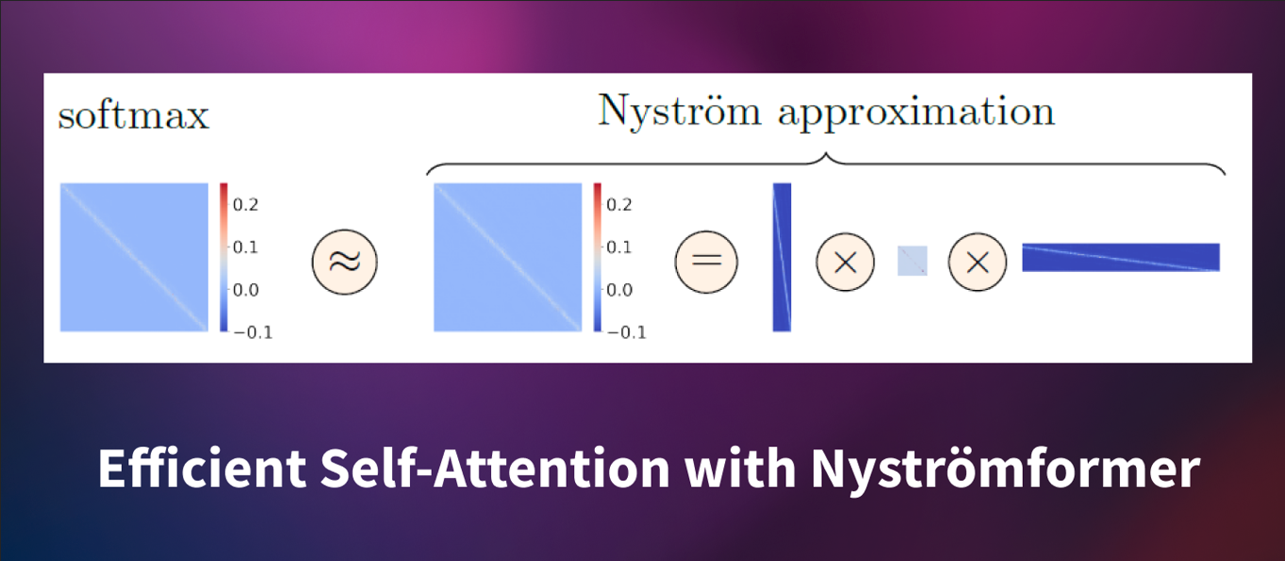
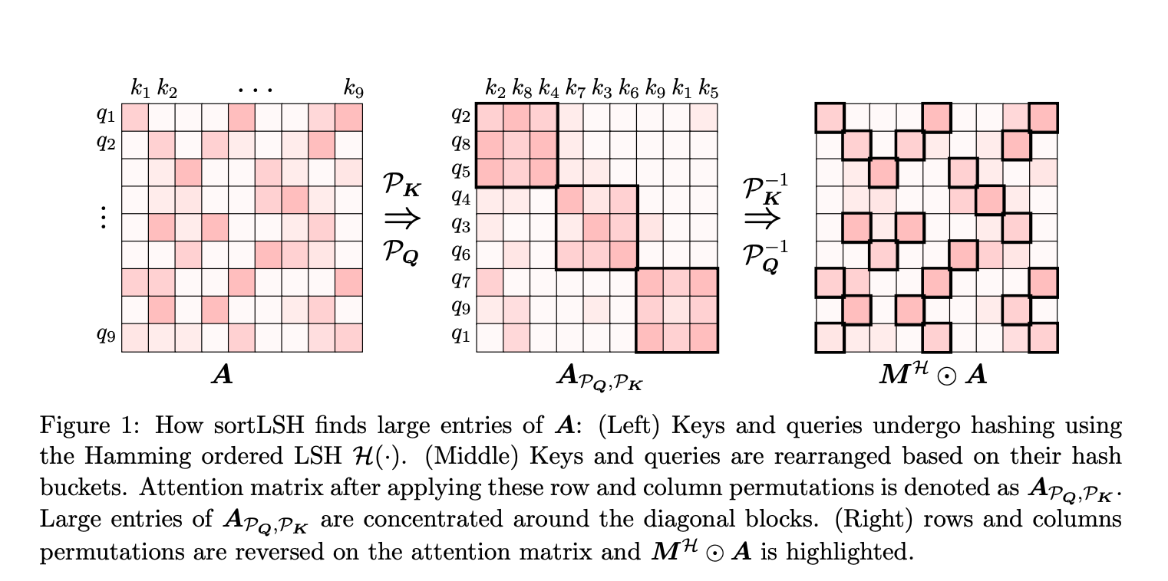
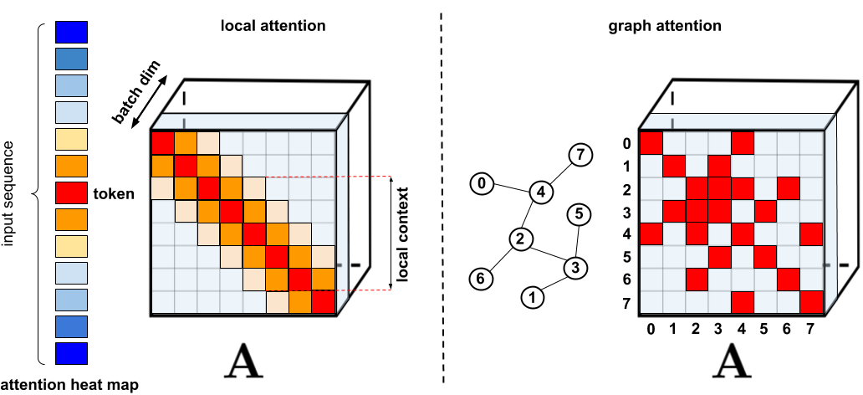
Time complexity isn’t about “time”
Linear time & memory complexity approximations of attention exist, yet do not exhibit similar reduction in real wall clock time
Flash attention has the same time complexity as vanilla attention O(n^2*d), yet is 4x faster?

Slide 4
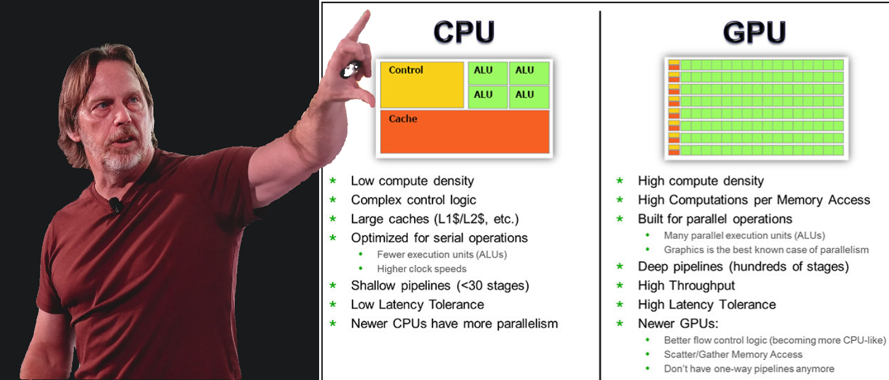
CPUs vs GPUs (vs DSPs)

Slide 5
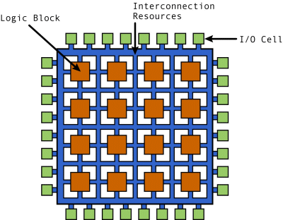
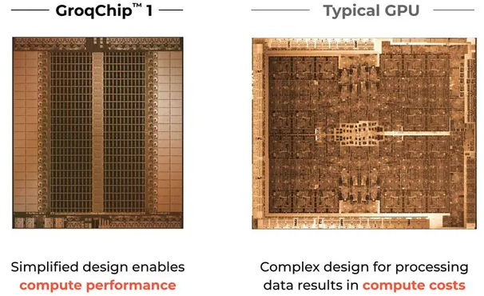
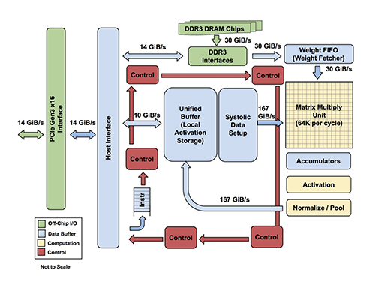
TPUs, FPGAs, DSPs, ASICs

Slide 6
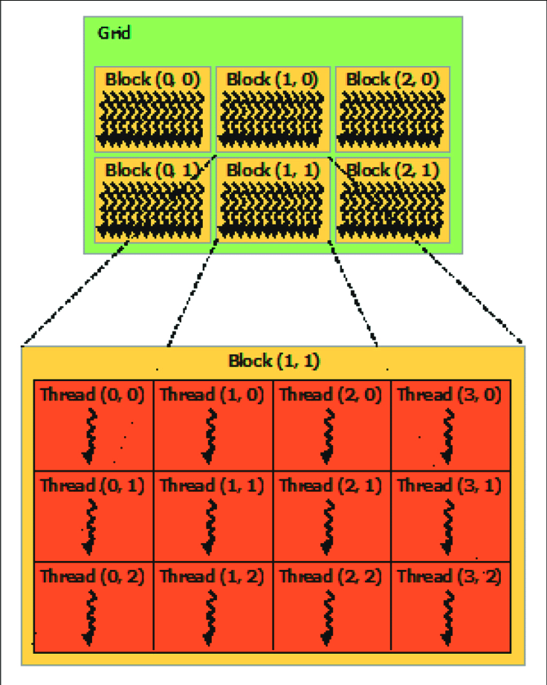
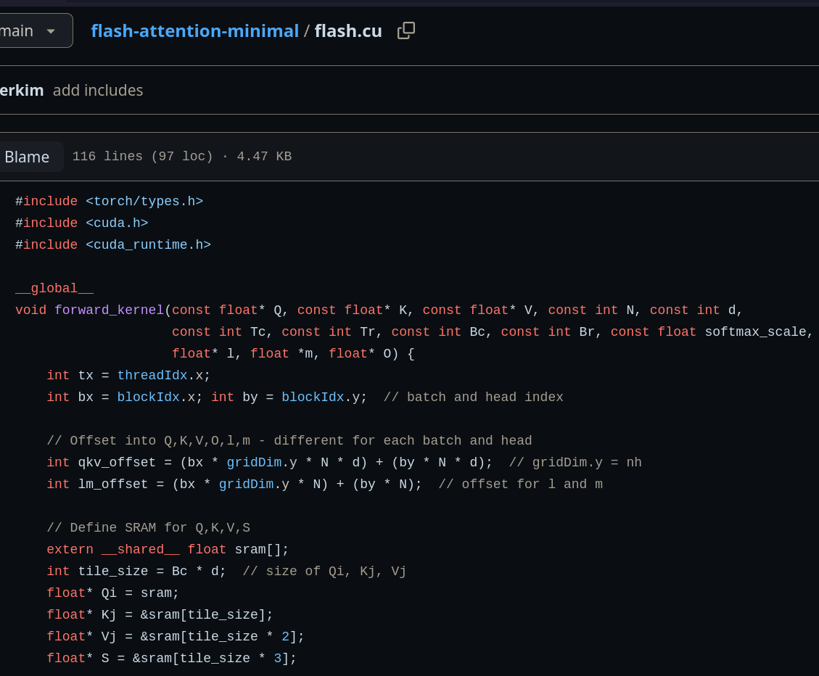
GPU (CUDA) programming primer
Kernel -> Grid -> Block -> (Warp (Thread))

Slide 7
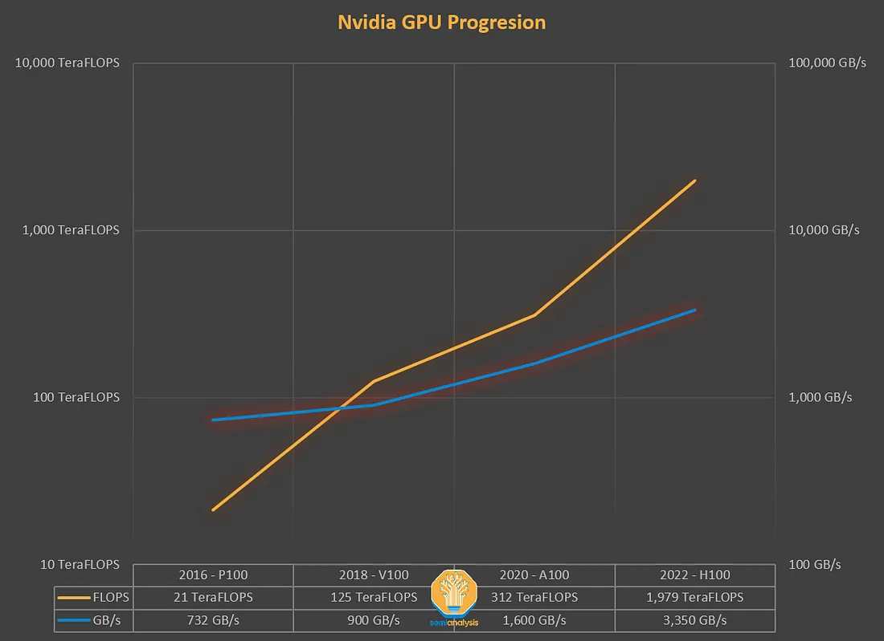
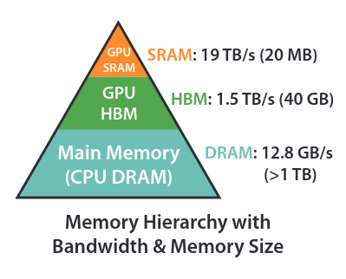
Compute vs Memory bound

Slide 8

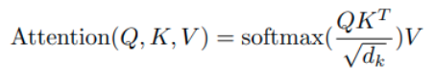

Attention
http://www.isattentionallyouneed.com/

Slide 9
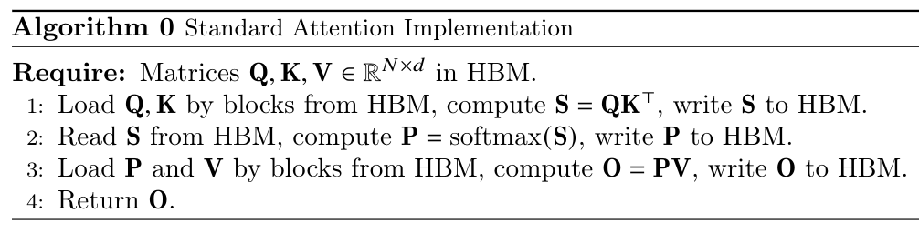
Vanilla attention
Written naively in PyTorch, each operation would require at least a full round trip between HBM and SRAM
-> Moving memory is the bottleneck

Slide 10
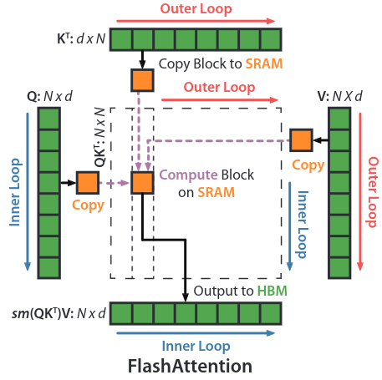
Flash Attention 1
Essentially boils down to 2 tricks:
Tiling QK^T using same trick as GEMM
Factorization of softmax
Doing these avoids manifesting the full softmax(QK^T), reducing memory complexity from ~O(n^2) to O(n)

Slide 11
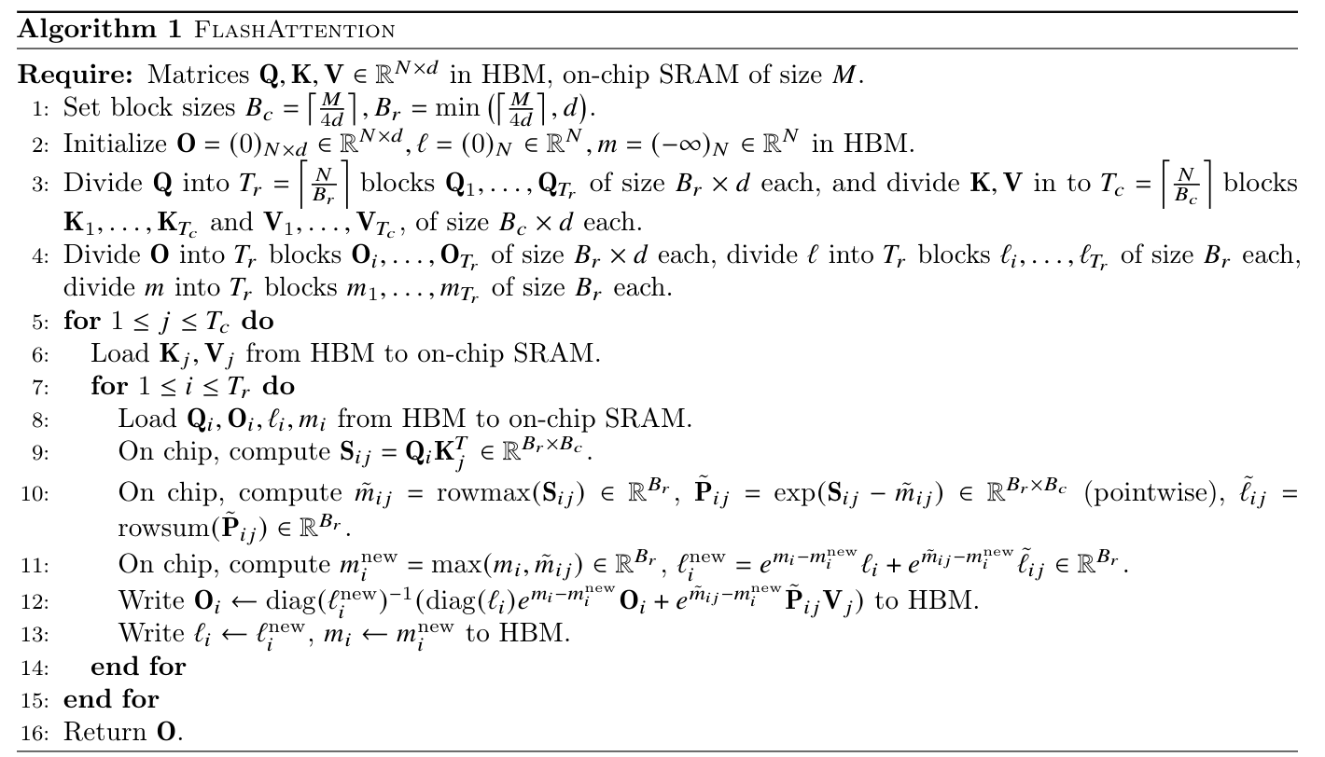

Slide 12
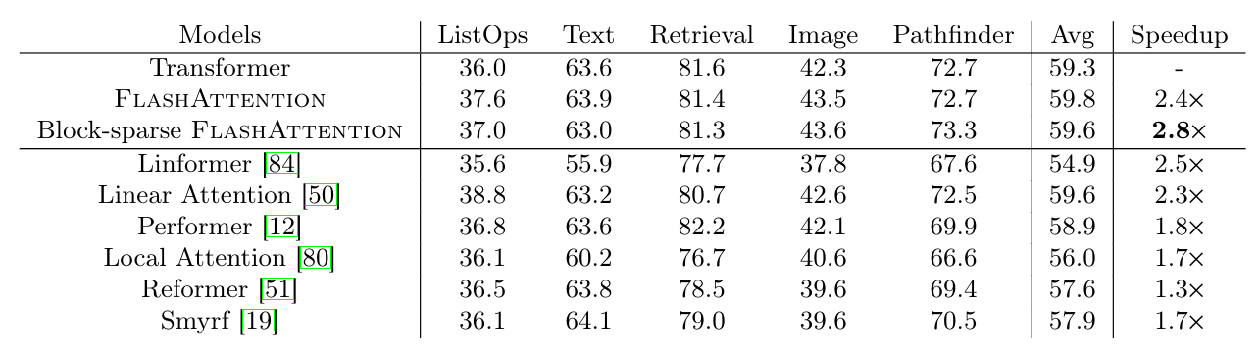
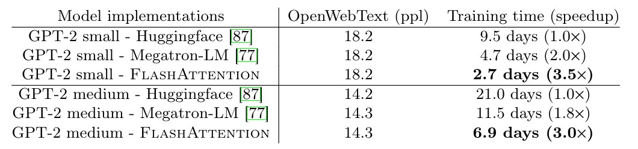
Flash Attention 1 results

Slide 13
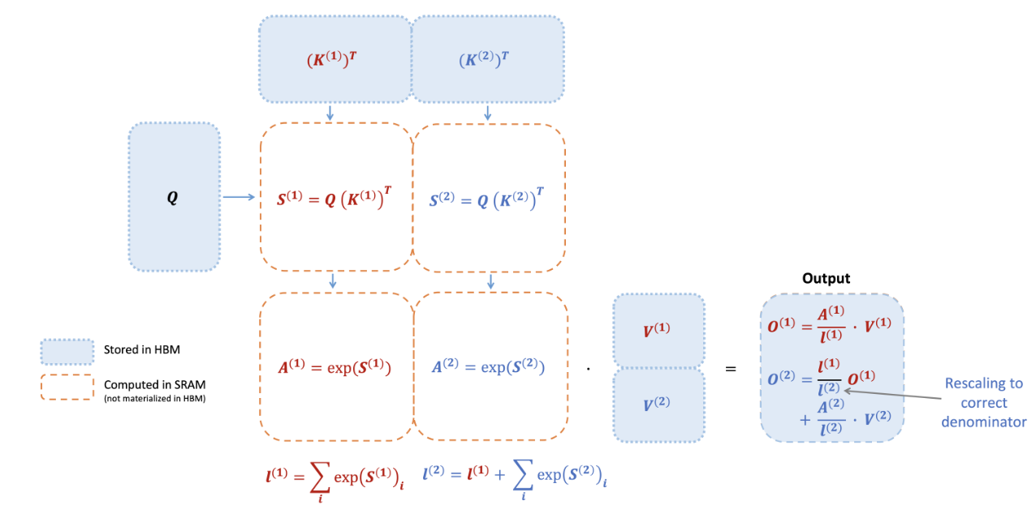
Flash Attention 2: Electric Boogaloo
Essentially the same algorithm, with 1 new softmax trick, and some shuffled memory accesses

Slide 14
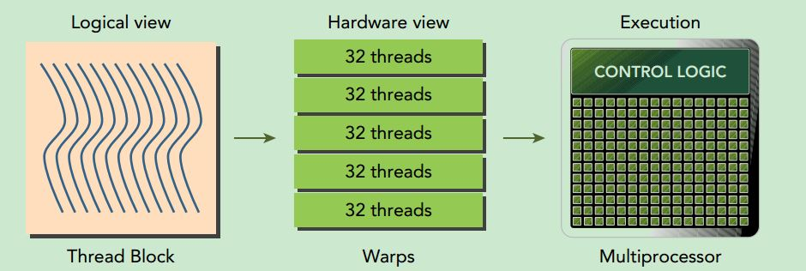
Warps
Kernel: Grid -> Block -> Wrap (Thread)

Slide 15
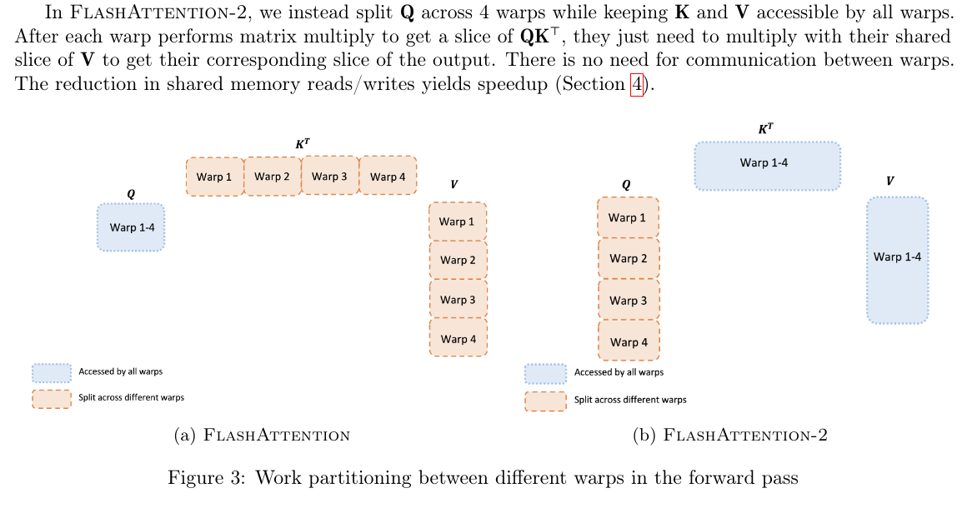
Flash attention 2 - memory

Slide 16
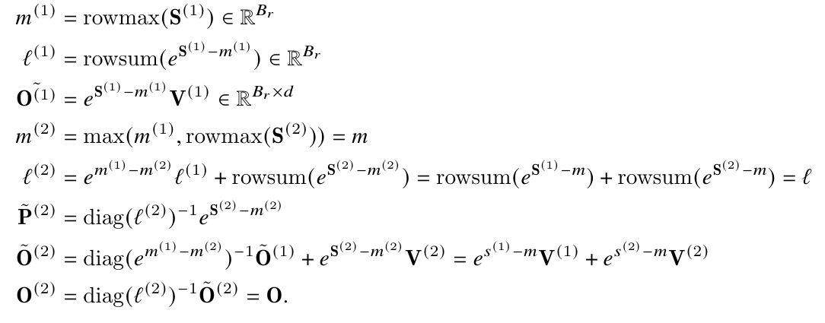
Flash attention 2 - softmax

Slide 17
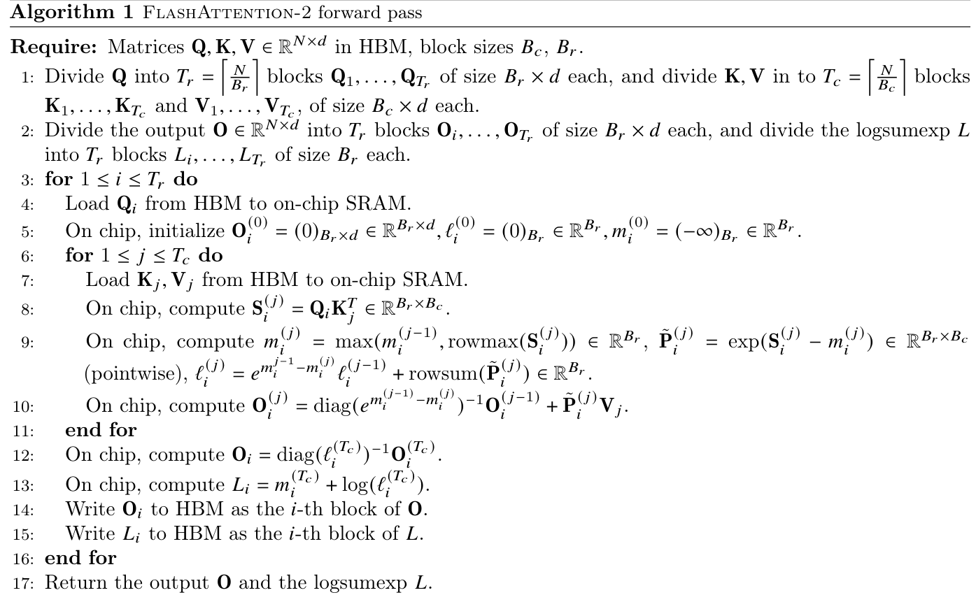

Slide 18
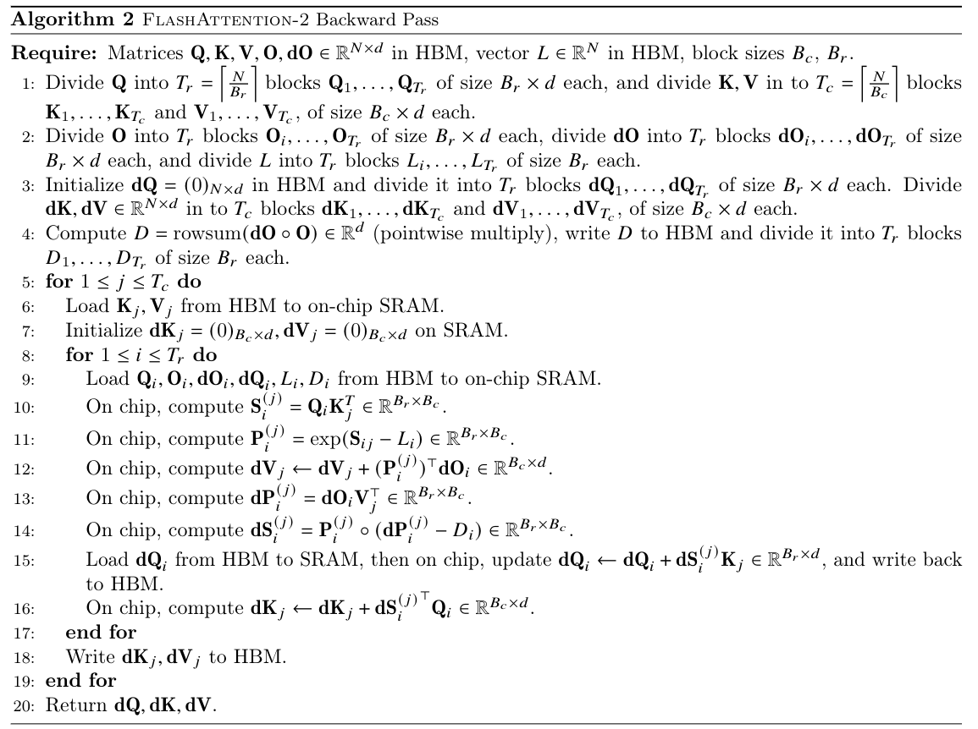

Slide 19
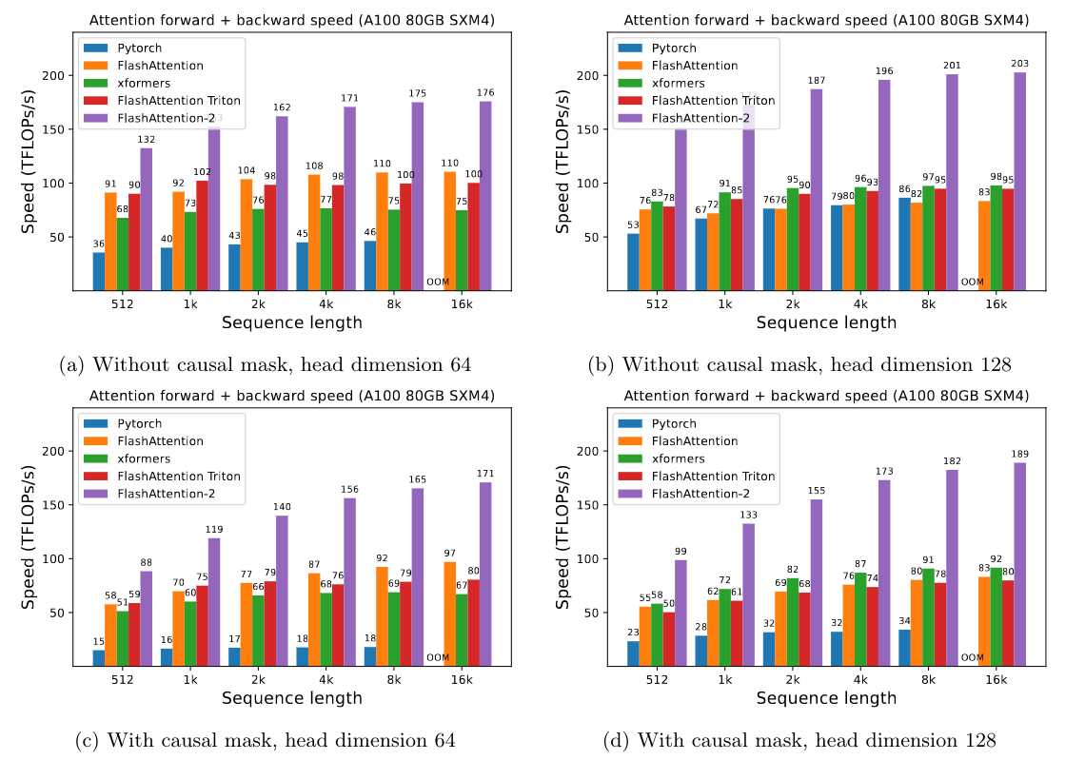
Flash Attention 2 results

Slide 20
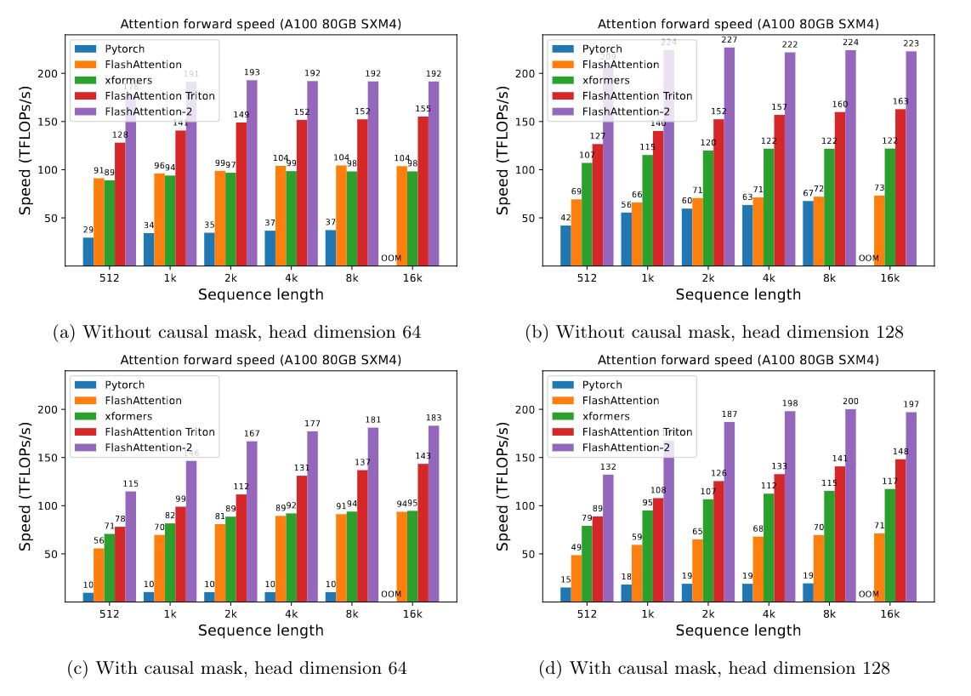

Slide 21
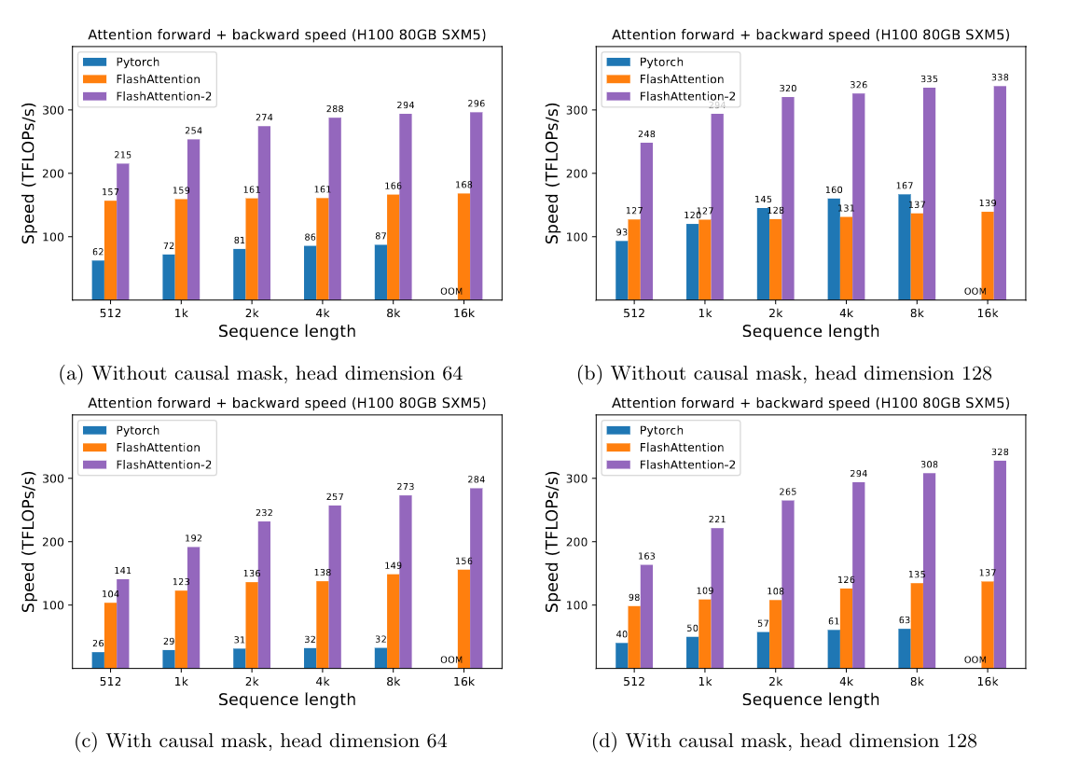

Slide 22
Happy users
Libraries: Pytorch, Hugging Face transformers library, Microsoft's DeepSpeed, Nvidia's Megatron-LM, MosaicML Composer library, EleutherAI's GPT-NeoX, PaddlePaddle, Huggingface's diffusers library, Colossal-AI's implementation of Stable Diffusion, Uni-Fold, OpenFold, Triton, xformers, Jax, Metal
Companies: Microsoft, Nvidia, MosaicML, Meta, Kernl, Stanford CRFM, Labml.ai, OpenAI, Azure, Hazy Research

Slide 23
Limitation
Needs to be a handwritten kernel due to high level library limitations
Because it’s essentially assembly, needs to be rewritten for each different hardware architectures
Doesn’t really support anything besides nvidia
No mixed precision support, limited support for low bit dtypes

Slide 24
Questions?

Slide 25
https://arxiv.org/abs/2205.14135
https://arxiv.org/abs/2307.08691
https://gordicaleksa.medium.com/eli5-flash-attention-5c44017022ad

